Slide 1
Evaluating Multi-input Multi-target Models (Nasdaq, S&P500,S&P500 VIX, Dow Jones) With Linear SVC and Aphelens
APS 1052 AI in Finance Final Project
By Steven Xie 998979627

Slide 2

Base Model
S6.Miscellaneous\ModelEvaluationUsingAlphalens.rar\pharma_stocks_RETPRED_PREDPROBA.ipynb

Slide 3
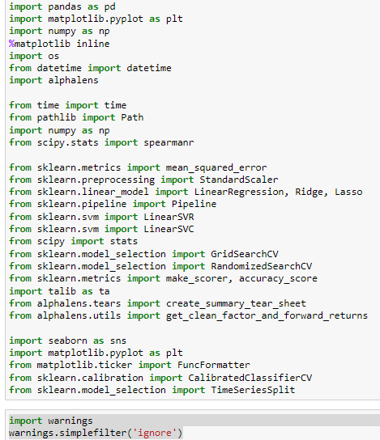
Python Libraries Import

Slide 4
Patch Version
python=3.10.1
seaborn==0.11.2
scipy==1.7.3
scikit-learn==1.0.2
ta-lib==0.4.19
alphalens-reloaded == 0.4.2
pandas==1.4.2
matplotlib==3.5.1
numpy == 1.21.5

Slide 5

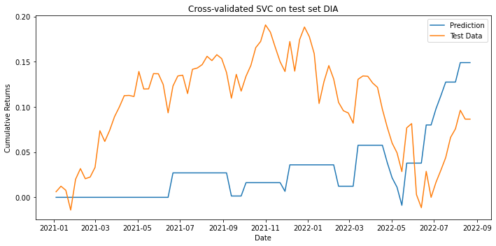
Main Idea Linear SVC
Make predictions of returns Multiple Assets (Main US stock Indices)

Slide 6
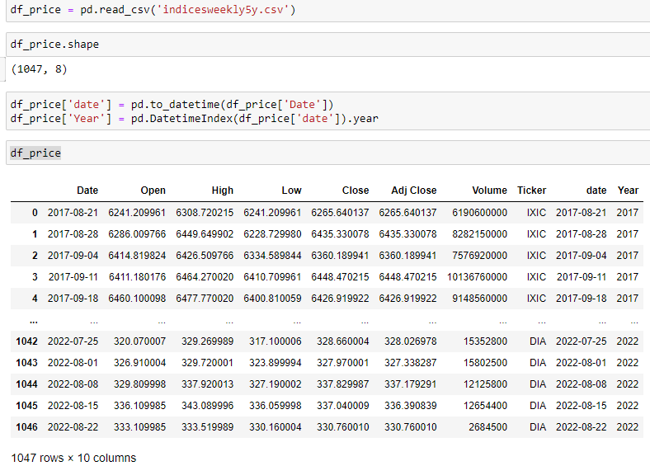
Data Loading
Notes:
5 years of each indices weekly is picked from Yahoo.com

Slide 7
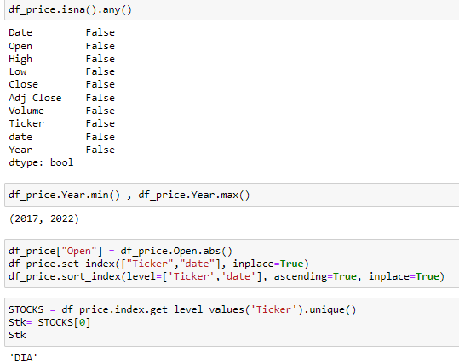
Data Processing
Check if there is blank grid in the dataset
The dataset from 2017 to 2022
Creating a Year column for train and test data filtering in model fitting loop
Get stock names of each Indices

Slide 8
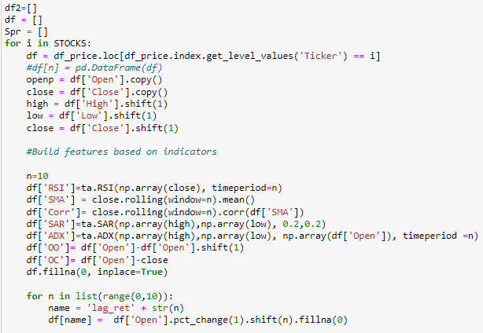
Data Processing
Draw the open close high low price of the week from the dataframe
Create Indicators through Ta-lib (RSI, SAR, ADX)

Slide 9
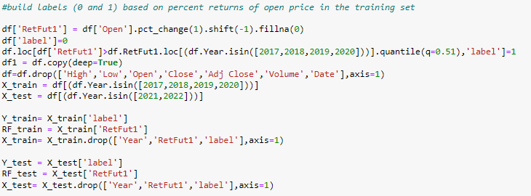
Data Processing
Split the train test set of the dataset. (Use 2017-2020 data as train data, and compare to the test data 2021,2022 later)

Slide 10
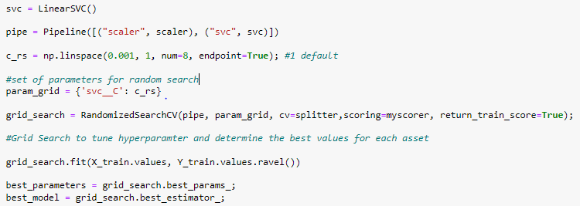
Grid Search with Linear SVC
Standard scaler is used
Best model is selected through grid search

Slide 11
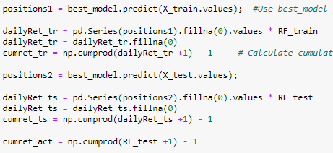
Grid Search with Linear SVC
Predict the X_train value use the best model and calculate the return
Predict the test value for comparison later with the real data

Slide 12
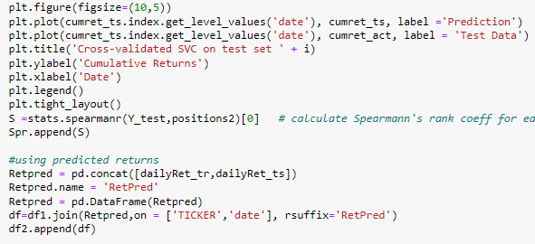
Plot the Cross Validation on SVC

Slide 13
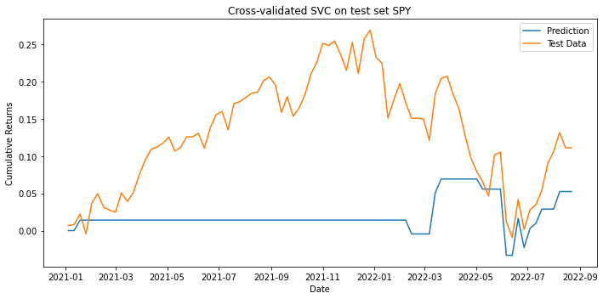
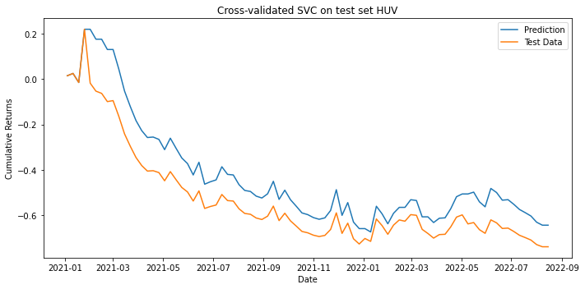
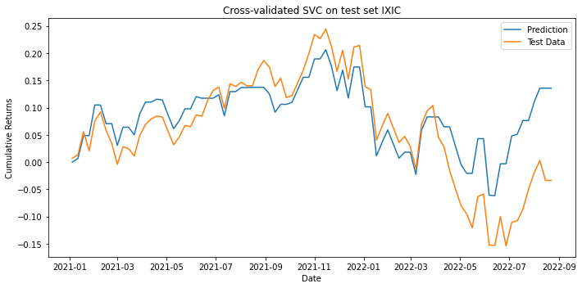
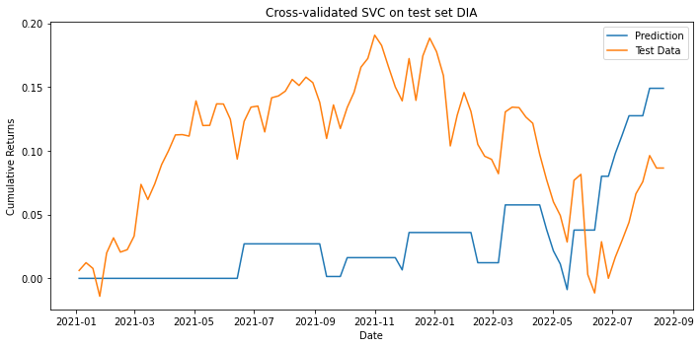
Cross Validation Graph
The test result is not exactly good vs the prediction for DIA and SPY, it is the influence of Covid 19 starting 2020 that had a huge interference of the stock market

Slide 14
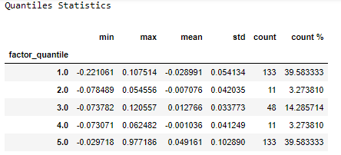
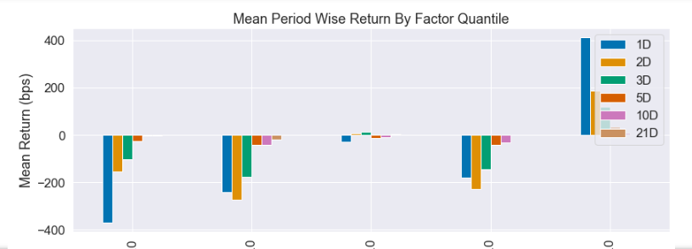
Main Idea Aphelens
Make predictions of returns on different period on Multiple Assets (Main US stock Indices)

Slide 15
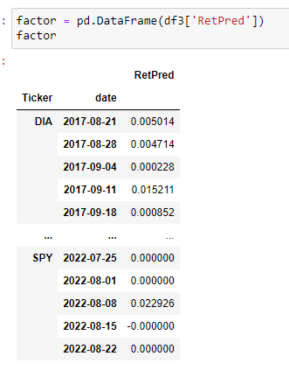
Initial Input

Slide 16
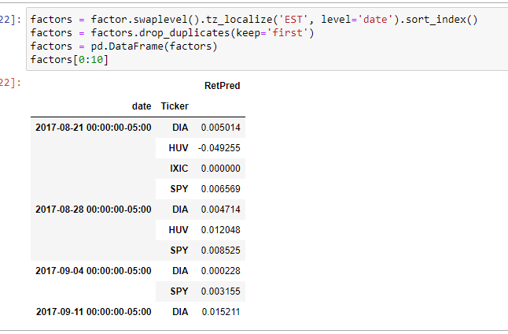
Process the data
drop duplicates in index as Alphalens gives error with non-unique values

Slide 17
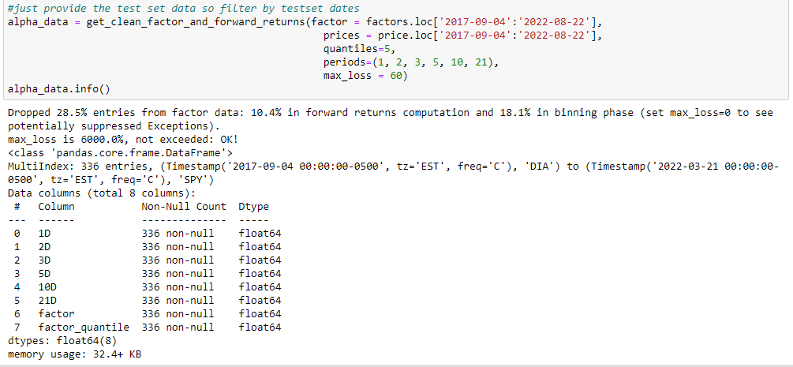

Slide 18
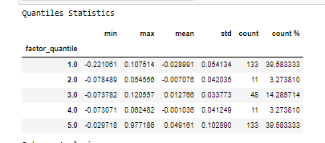
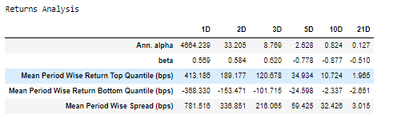
Create the summary
create_summary_tear_sheet(alpha_data)

Slide 19
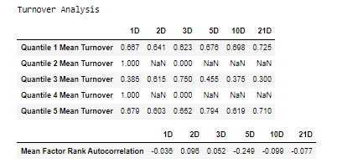
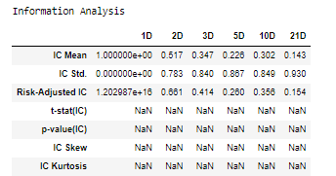

Slide 20
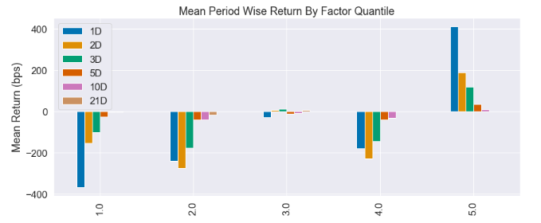
Return by Different Period of Time
Holding period
If the predictions have predictive power, you should see:
Large negative realized returns (****) in quantile 1 containing the lowest predicted returns, and
High positive realized returns (*) in quantile 5 containing the highest predicted returns.

Slide 21
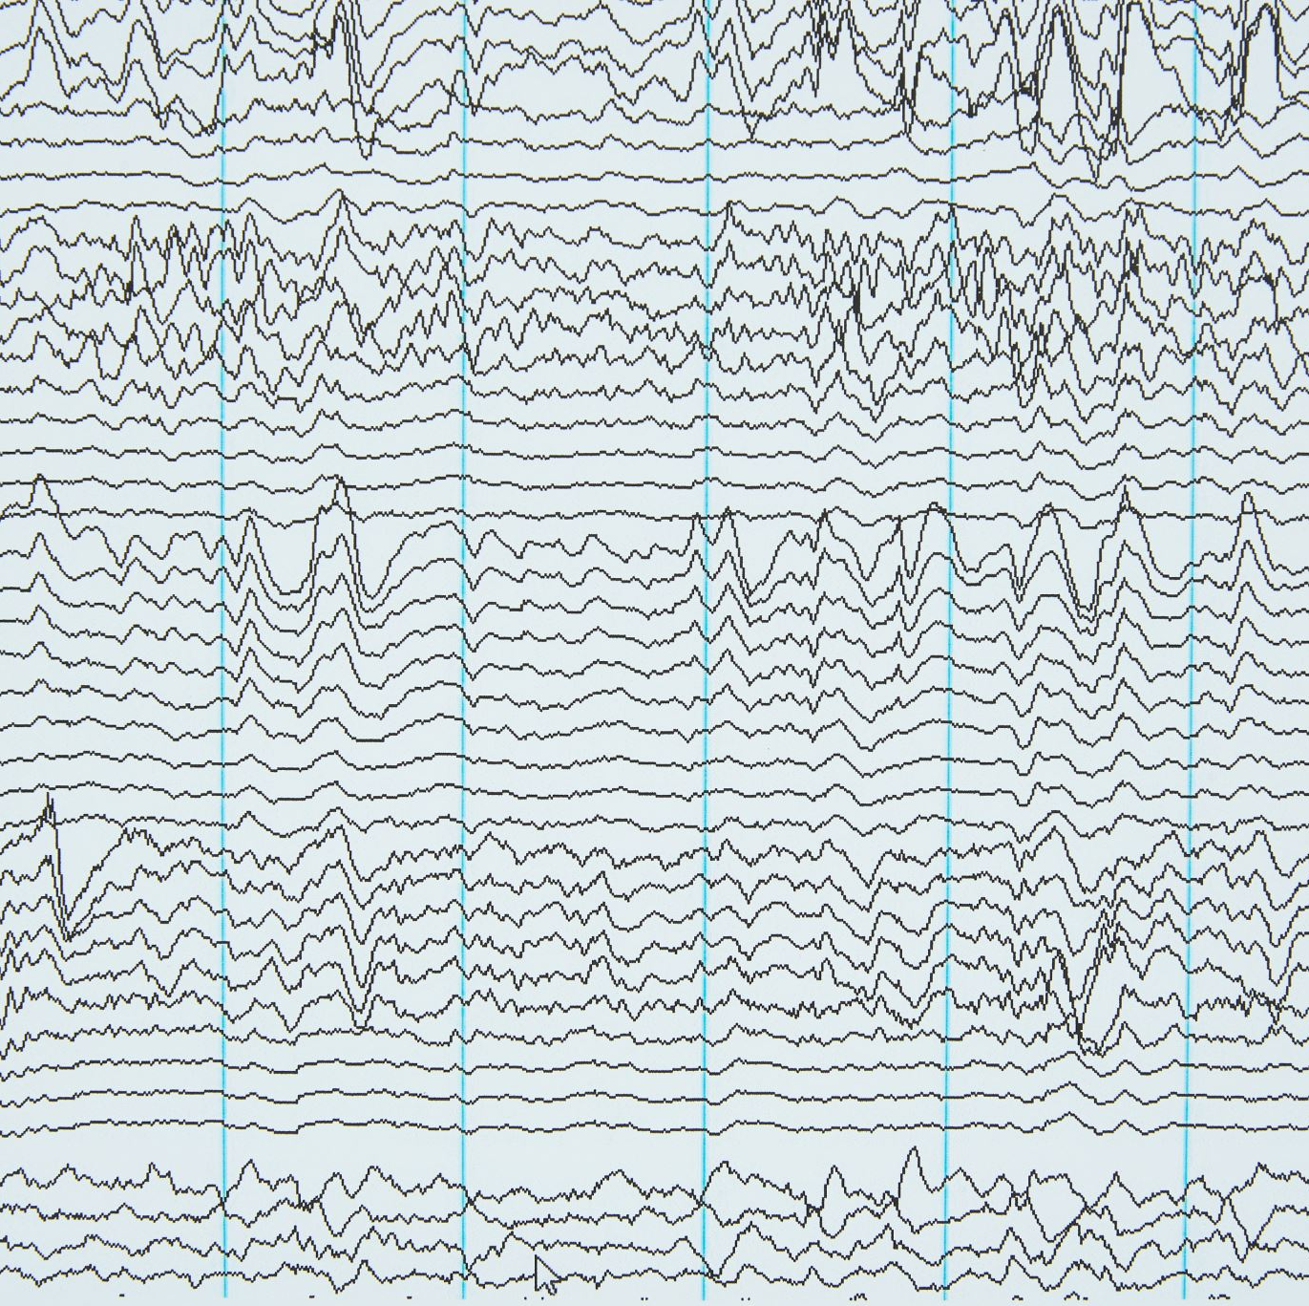
Tear sheet
from alphalens.tears import create_full_tear_sheet
alphalens.tears.create_full_tear_sheet(alpha_data, long_short=True, group_neutral=False, by_group=False)

Slide 22
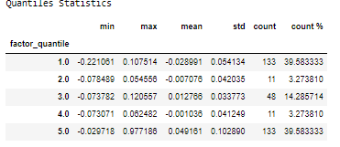
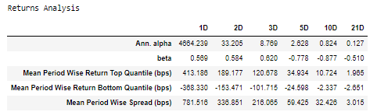
Tear sheet

Slide 23
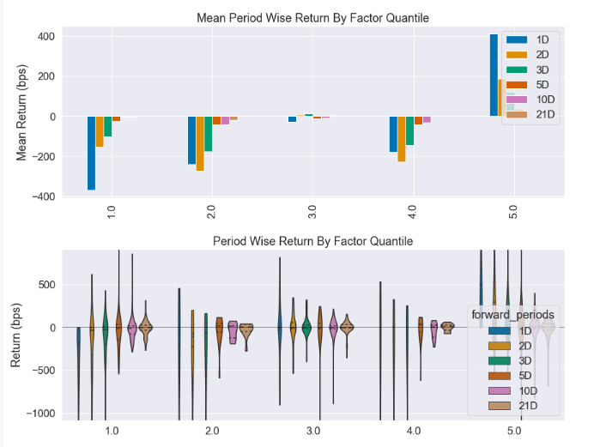

Slide 24
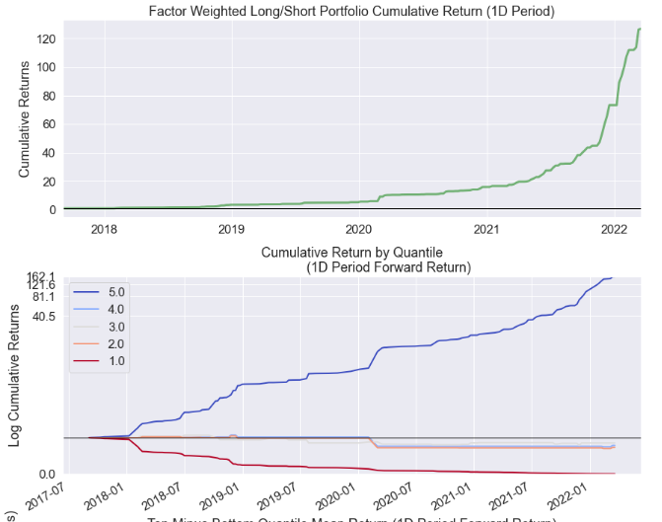

Slide 25
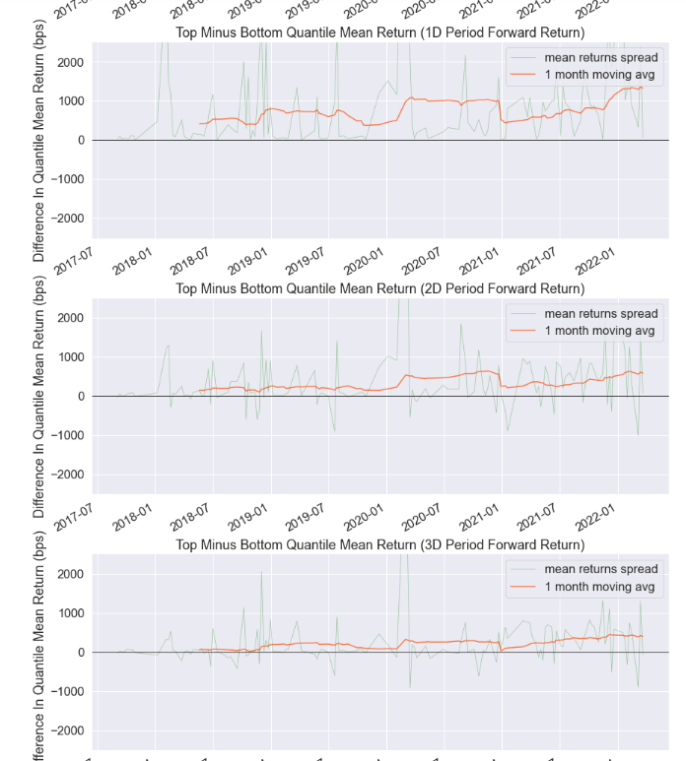

Slide 26
